Slide 1
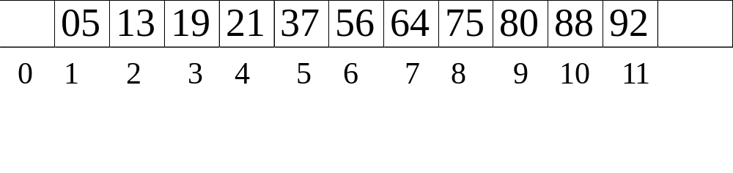
CHAPTER 5
HASHING
Binary Search :
Find key from a sorted list f [1 ].key, f [ 2].key, ... , f [ n].key.
key=64
n
f
low
low
high
high
mid
mid
mid
mid = (low+high)/2
Notes:
Hash is some kind of search. Power of computer is data processing. In many appl, we need search data according to key. A simple way is seq search, time complexity is O(n), to increase eff of search, we need org data in some way, eg binary search tree. There is another way which is called binary search, before search we need sort data in some order. Binary search can not locate data accurately.

Slide 2
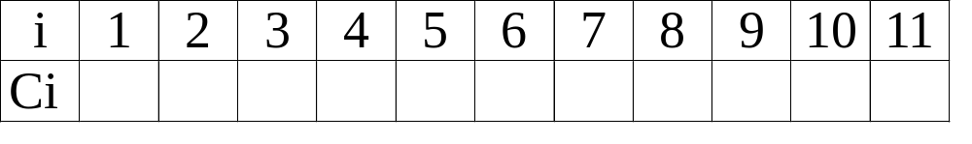
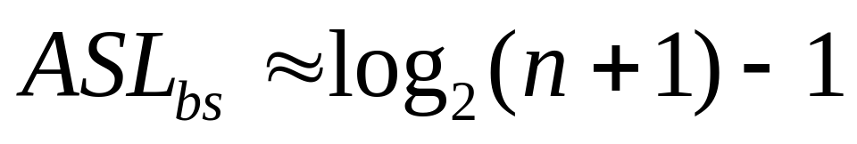
3
4
2
3
4
1
3
4
2
3
4
6
3
9
1
4
7
10
2
5
8
11

Slide 3



Search by Formula
Interpolation Search :
Find key from a sorted list f [ l ].key, f [ l+1 ].key, ... , f [ u ].key.
f[u].key
key
f[l].key
l
i ?
u
If ( f [ i ].key < key ) l = i+1 ;
Else u = i-1 ;
n elements
Notes:
11.11
Interpolation篡改, 添写, 插补
Interpolation Search内插查找;插值搜索
Hash is some kind of search. Power of computer is data processing. In many appl, we need search data according to key. A simple way is seq search, time complexity is O(n), to increase eff of search, we need org data in some way, eg binary search tree. There is another way which is called binary search, before search we need sort data in some order. Binary search can not locate data accurately.

Slide 4
§1 General Idea
Hash Tables
For each identifier x, we define a hash function
f ( x ) = position of x in ht[ ] (i.e.
the index of the bucket
that contains x )
[0]
[1]
… …
[s−1]
… …
ht [ 0 ]
… …
ht [ 1 ]
… …
… …
b buckets
 T ::= total number of distinct possible values for x
ht [b−1]
… …
 n ::= total number of identifiers in ht[ ]
s slots
 identifier density ::= n / T
 loading density λ ::= n / (s b)
Notes:
hash table is a such method in which we search key by cal position rather than by comp. A hash table is usually represented by an array, each elem of array is a bucket, each bucket may have several slot which store data. Big diff compared with other search data structures(binary search tree, b-tree) is we calculate position of data according key, not by comparison

Slide 5

§1 General Idea
 A collision occurs when we hash two nonidentical identifiers into the same bucket, i.e. f ( i₁ ) = f ( i₂ ) when i₁ ≠ i₂ .
 An overflow occurs when we hash a new identifier into a full bucket.
Collision and overflow happen
simultaneously if s = 1.
〖Example〗 Mapping n = 10 C library functions into a hash table ht[ ] with b = 26 buckets and s = 2.
Loading density λ = ?
10 / 52 = 0.19
Slot 0
Slot 1
0
acos
atan
To map the letters a ~ z to 0 ~ 25, we may define f ( x ) = ?
1
x [ 0 ] − ‘a’
2
char
ceil
3
define
acos
define
float
exp
char
4
exp
atan
ceil
floor
clock
ctime
5
float
floor
6
Without overflow,
T_{search} = T_{insert} = T_{delete} = O( 1 )
……
25

Slide 6

§2 Hash Function
Properties of f :
① f ( x ) must be easy to compute and minimizes the number of collisions.
② f ( x ) should be unbiased. That is, for any x and any i, we have that Probability( f ( x ) = i ) = 1 / b. Such kind of a hash function is called a uniform hash function.
f ( x ) = x % TableSize ; /* if x is an integer */
☹ What if TableSize = 10 and x’s are all end in zero?
☺ TableSize = prime number ---- good for random integer keys
Notes:
In most time of following lecture, the hash tablewe talk about has only one slot for each

Slide 7
§2 Hash Function
f ( x ) = (Σ x[i]) % TableSize ; /* if x is a string */
〖Example〗 TableSize = 10,007 and string length of x ≤ 8.
If x[i] ∈ [0, 127], then f ( x ) ∈ [0, ? ]
1016
☹
f ( x ) = (x[0]+ x[1]*27 + x[2]*27²) % TableSize ;
Total number of combinations = 26³ = 17,576
☹ Actual number of combinations < 3000

Slide 8
§2 Hash Function
f ( x ) = (Σ x[N − i − 1] * 32^{i} ) % TableSize ;
…………
x[0]
x[1]
x[N-2]
x[N-1]
Faster than *32
Index Hash3( const char *x )
{
unsigned int HashVal = 0;
/* 1*/ while( *x != '\0' )
/* 2*/ HashVal = ( HashVal << 5 ) + *x++;
/* 3*/ return HashVal % TableSize;
}
 Carefully select some characters from x.
☹ If x is too long (e.g. street address), the early characters will be left-shifted out of place.

Slide 9

§3 Separate Chaining
---- keep a list of all keys that hash to the same value
struct ListNode;
typedef struct ListNode *Position;
struct HashTbl;
typedef struct HashTbl *HashTable;
struct ListNode {
ElementType Element;
Position Next;
};
typedef Position List;
/* List *TheList will be an array of lists, allocated later */
/* The lists use headers (for simplicity), */
/* though this wastes space */
struct HashTbl {
int TableSize;
List *TheLists;
};
H
TheLists
……
TableSize
……

Slide 10
☞ Create an empty table
§3 Separate Chaining
HashTable InitializeTable( int TableSize )
{ HashTable H;
int i;
H = malloc( sizeof( struct HashTbl ) ); /* Allocate table */
H->TableSize = TableSize ; /* Better be prime */
H->TheLists = malloc( sizeof( List ) * H->TableSize ); /*Array of lists*/
for( i = 0; i < H->TableSize; i++ ) { /* Allocate list headers */
H->TheLists[ i ] = malloc( sizeof( struct ListNode ) ); /* Slow! */
H->TheLists[ i ]->Next = NULL;
}
return H;
}
H
TheLists
……
TableSize
……

Slide 11
§3 Separate Chaining
☞ Find a key from a hash table
Position Find ( ElementType Key, HashTable H )
{
Position P;
List L;
L = H->TheLists[ Hash( Key ) ];
P = L->Next;
while( P != NULL && P->Element != Key ) /* Probably need strcmp */
P = P->Next;
return P;
}
Your hash function
Identical to the code to perform a Find for general lists -- List ADT

Slide 12
☞ Insert a key into a hash table
§3 Separate Chaining
☹ Again?!
void Insert ( ElementType Key, HashTable H )
{
Position Pos, NewCell;
List L;
Pos = Find( Key, H );
if ( Pos == NULL ) { /* Key is not found, then insert */
NewCell = malloc( sizeof( struct ListNode ) );
L = H->TheLists[ Hash( Key) ];
NewCell->Next = L->Next;
NewCell->Element = Key; /* Probably need strcpy! */
L->Next = NewCell;
}
}
Tip: Make the TableSize about as large as the number of keys expected (i.e. to make the loading density factor λ≈1).

Slide 13
§4 Open Addressing
---- find another empty cell to solve collision (avoiding pointers)
Algorithm: insert key into an array of hash table
{
if ( table is full ) {
ERROR (“No space left”);
exit;
}
index = hash(key);
initialize i = 0 ------ the counter of probing;
while ( collision at index ) {
index = ( hash(key) + f(++i) ) % TableSize;
}
insert key at index;
}
Collision resolving function.
Tip: Generally λ < 0.5.

Slide 14


§4 Open Addressing
f ( i ) = i ; /* a linear function */
1. Linear Probing
〖Example〗 Mapping n = 11 C library functions into a hash table ht[ ] with b = 26 buckets and s = 1.
Although p is small,
the worst case can be
LARGE.
Cause primary clustering: any key that hashes into the cluster will add to the cluster after several attempts to resolve the collision.
bucket
x
search time
acos atoi char define exp ceil cos float atol floor ctime
0
acos
1
1
atoi
2
2
char
1
Loading density λ = 11 / 26 = 0.42
3
define
1
4
exp
1
5
ceil
4
Average search time = 41 / 11 = 3.73
6
cos
5
7
float
3
8
atol
9
9
floor
5
Analysis of the linear probing show that the expected number of probes
10
ctime
9
… …
25
= 1.36

Slide 15
§4 Open Addressing
2. Quadratic Probing
f ( i ) = i ² ; /* a quadratic function */
【Theorem】If quadratic probing is used, and the table size is prime, then a new element can always be inserted if the table is at least half empty.
Note: If the table size is a prime of the form 4k + 3, then the quadratic probing f(i) = ± i ² can probe the entire table.

Slide 16
§4 Open Addressing
f ( i ) = i ² ; /* a quadratic function */
〖Example〗 Mapping n = 9 C library functions into a hash table ht[ ] with b = 26 buckets and s = 1.
acos atoi char define exp ceil cos float atol
bucket
x
search time
0
acos
1
1
atoi
2
2
char
1
Loading density λ = 9 / 26 = 0.35
3
define
1
4
exp
1
5
float
1
Average search time = 18 / 9 = 2
6
ceil
3
7
8
9
atol
4
Find ceil, ctime
Delete ceil
10
11
cos
4
… …
Question: Why not empty cell when deleting an element?

Slide 17
§4 Open Addressing
enum KindOfEntry { Legitimate, Empty, Deleted };
struct Cell{
ElementType Element;
enum KindOfEntry Info;
};
struct HashTbl {
int TableSize;
Cell *TheCells;
};
typedef unsigned int Position;
typedef struct HashTbl *HashTable;
Notes:
((i-1)+1)^2=(i-1)^2 + 2(i-1)+1

Slide 18
§4 Open Addressing
HashTable InitializeTable( int TableSize )
{
HashTable H;
int i;
H = malloc( sizeof( struct HashTbl ) );
H->TableSize = TableSize ;
H->TheCells = malloc( sizeof( Cell ) * H->TableSize );
for( i = 0; i < H->TableSize; i++ )
H->TheCells[ i ].Info = Empty;
return H;
}
Notes:
12.5
((i-1)+1)^2=(i-1)^2 + 2(i-1)+1

Slide 19
§4 Open Addressing
What if these two conditions are switched?
Position Find ( ElementType Key, HashTable H )
{
CollisionNum = 0;
CurrentPos = index = Hash( Key, H->TableSize );
while( H->TheCells[ index].Info != Empty &&
H->TheCells[ CurrentPos ].Element != Key ) {
CurrentPos += 2 * ++CollisionNum − 1;
index = CurrentPos % H->TableSize;
}
return index;
}
What is returned?
Notes:
((i-1)+1)^2=(i-1)^2 + 2(i-1)+1

Slide 20
§4 Open Addressing
void Insert ( ElementType Key, HashTable H )
{
Position Pos;
Pos = Find( Key, H );
if ( H->TheCells[ Pos ].Info != Legitimate ) { /* OK to insert here */
H->TheCells[ Pos ].Info = Legitimate;
H->TheCells[ Pos ].Element = Key; /* Probably need strcpy */
}
}
Question: How to delete a key?
Note: ① Insertion will be seriously slowed down if there are too many deletions intermixed with insertions.
② Although primary clustering is solved, secondary clustering occurs – that is, keys that hash to the same position will probe the same alternative cells.
Notes:
11-18
因为通过find只能找到empty或相等的关键字

Slide 21
3. Double Hashing
§4 Open Addressing
f ( i ) = i * hash₂( x ); /* hash₂( x ) is the 2nd hash function */
 hash₂( x ) ≡ 0 ;
 make sure that all cells can be probed.
 Tip: hash₂( x ) = R – ( x % R ) with R a prime smaller than TableSize, will work well.

Slide 22


§5 Rehashing
Uhhhh…
insertion might fail ☹
What will happen
if the table is more than half full?
Because
I enjoy giving you headaches …
Just kidding ☺
Say which probing method
do you like?
Practically speaking
I would prefer to use quadratic hashing…
What, anything wrong with it?
Oh come on! Haven’t we had
enough hashing methods?
Why do we need rehashing ?
☞ Build another table that is about twice as big;
☞ Scan down the entire original hash table for non-deleted elements;
☞ Use a new function to hash those elements into the new table.
Then what can we do?
If there are N keys in the table, then T (N) =
O(N)
Question: When to rehash?
Answer:
① As soon as the table is half full
② When an insertion fails
③ When the table reaches a certain load factor

Slide 23
查找—2005试题
哈希表用_______________确定记录的存储位置。
哈希函数H(key)

Slide 24
查找—2006试题
在哈希造表中，不同的关键字产生同一哈希地址的现象，称为______。
冲突

Slide 25
查找—2007试题
哈希表查找方法与其他查找方法最大的不同是，其他查找方法是建立在“比较”的基础上，而哈希表查找方法则是_______________________。
根据关键字计算出数据存储的位置

Slide 26
查找—2008试题
请回答下列与哈希表有关的问题：
(1) 哈希表查找与其他查找方法的根本区别是什么？
(2) “好”的哈希函数的主要要求是什么？
(3) 比较线性探测再散列与二次探测再散列的主要优缺点。
（1）哈希表不是基于比较而是通过计算存储位置进行查找
（2）哈希地址应均匀分布在整个地址空间中，从而减少冲突
（3）线性探测再散列可以确保找到可用的空间，而2次探测再散列不能保证；但线性探测再散列有‘聚集‘问题。

Slide 27
查找
设哈希函数为H(key) = key%7，装填因子为0.8，对下面的关键字集{30, 15, 21, 40, 25, 26, 36, 37}，采用线性探测再哈希方法解决冲突：
（1）建立哈希表；
（2）分别计算出在等概率情况下查找成功与不成功的平均查找长度。
哈 希 地 址 | 0 | 1 | 2 | 3 | 4 | 5 | 6 | 7 | 8 | 9
关 键 字 | 21 | 15 | 30 | 36 | 25 | 40 | 26 | 37
比 较 次 数 | 1 | 1 | 1 | 3 | 1 | 1 | 2 | 6
查找成功的平均查找长度 = 2；查找不成功的平均查找长度 = 4.6。
Notes:
试题分析：
① 由于装填因子为0.8，关键字有8个，所以表长为8/0.8 = 10。
② 哈希表中有8个关键字，在等概率情况下，成功查找的平均查找长度为
( 1 + 1 + 1 + 1 + 1 + 2 + 3 + 6)/8 = 2
③ 计算查找不成功的平均查找长度时，必须计算不在表中的关键字当其哈希地址为i（0≤i≤m − 1）时的查找次数。本例中m = 10。等概率情况下，不在表中的关键字其哈希地址为i的概率为1/10，不成功查找的平均查找长度为
（9 + 8 + 7 + 6 + 5 + 4 + 3 + 2 + 1 + 1）/10 = 4.6

Slide 28
Exercises
5.1, 5.2, 5.6

